Slide 1
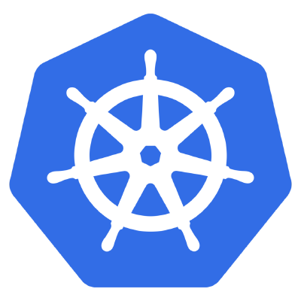

Minikube
Setup
Brought to you by

Slide 2
Overview of Minikube
An all-in-one install of Kubernetes
Takes all the distributed components of kubernetes and packages the into a single virtual machine to run locally
Important Caveats:
Minikube does not support cloud provider specific features such as Load Balancers, Persistent Volumes, Ingress (Don’t worry about these yet if you don’t know what these mean)
MiniKube requires Virtualization (runs in Virtualbox on Linux)
Minikube is not meant for production

Slide 3
Installing Minikube
Make sure you have VirtualBox or another hypervisor installed!
Install kubectl
Install minikube

Slide 4
Kubernetes concepts
Kubernetes Deployments are the high-level construct that define an application
For ex: each application we deploy on kubernetes will be a “deployment”
“Pods” are instances of a container in a deployment
“Services” are endpoints that export ports to the outside world
You can create, delete, modify and view information about any of these using the kubectl command or using the Kubernetes local UI

Slide 5
Minikube/kubectl basic commands
Start minikube
$ minikube start
Deploy a sample Kubernetes “deployment” to your local minkube
$ kubectl run test-minikube --image=gcr.io/google-containers/echoserver:1.4 --port=8080
Expose this deployment to an external network
$ kubectl expose deployment test-minikube --type=NodePort
List the “pods” of this deployment
$ kubectl get pod
Access the sample service
$ curl $(minikube service test-minikube --url)
Delete the deployment
$ kubectl delete deployment test-minikube
Stop minikube
minikube stop

